Slide 1

Some Definitions
Lot of Coding
Two Tricks
What are we going to do?

Slide 2

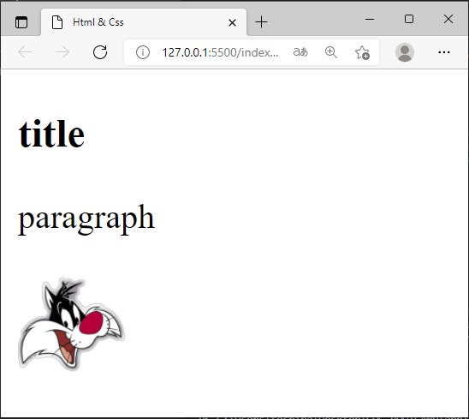
WHAT IS HTML ?
Hypertext Markup Language
Used to structure content on a web page <titles, images, paragraphs…>
We structure content using HTML tags
<h1> title </h1>
<p> paragraph </p>
<img>

Slide 3
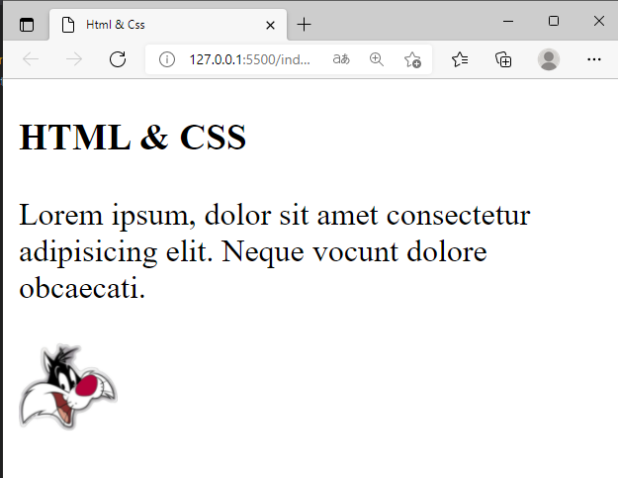
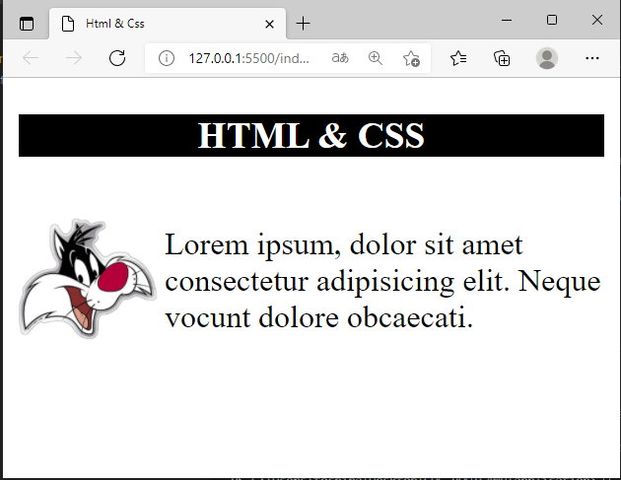
WHAT IS CSS ?
Cascading Style Sheet
Works alongside with HTML
Used to style web pages to make them look better<colors, fonts, positions…>

Slide 4




WHAT DO WE NEED?
Text Editor
Browser
Knowledge

Slide 5

CSS STYLE SHEET
A list of CSS rules
div{
background-color : white;
margin-top: 30px;
}
p{
font-size: 18px;
}
Selectors
Declarations

Slide 6
Inline Elements
Take exactly the space that their content needs
span, a, img, strong…
<span>
<a>
<strong>

Slide 7
Block Elements
Take all the width of the page their
div, p, h3, li…
<div>
<p>

Slide 8
Margin & Padding
<div>
<span>
Padding
Margin

Slide 9
Practice
Learn CSS animation
Dynamic webpages (js)
What to do next?

Slide 10

Thanks for your attention

